Slide 1
X-ray diffraction (XRD)
By Furkan Kaya

Slide 2
Layout of the lecture
Basic theory
Applications of XRD
A specific example: the XRD-lab in Oslo

Slide 3
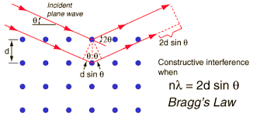
Theory of XRD
Braggs law: nλ =2d*sinθ .
Angle of incident = angle of scattering

Slide 4
Theory continues
Known angle (theta), wavelength and constructive interference gives atomic spacing (d)
From d = crystal structure of material
According to: d(hkl) =(a/(sqrt((h^2 + k^2 + l^2))) (cubic crystal structures)

Slide 5
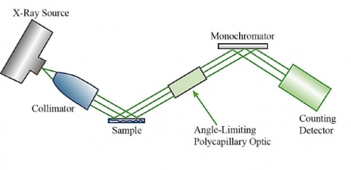
Applications of XRD - examples
Deciding whether a material was heusler or half-heusler
D = 6.06 Ångstrøm gives halfheusler
D = 6.36 Ångstrøm gives Heusler

Slide 6
Application 2: Pharmaceutical industry
Characterizing the composition
STEP 1: Isolate active drug, XRD diffraction to analyse crystal structure
STEP 2: Secure a patent and start to manufacture

Slide 7
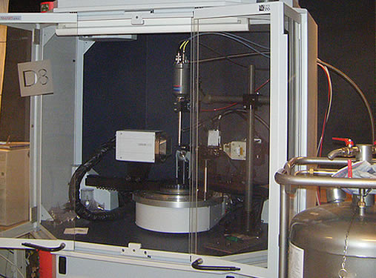
XRD-lab in Oslo
AFFILIATED WITH UIO
HAS ONE CRYSTAL XRD INSTRUMENT (APEX)
AND SEVERAL POWDER XRD INSTRUMENTS

Slide 8
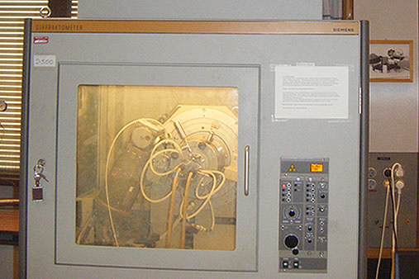
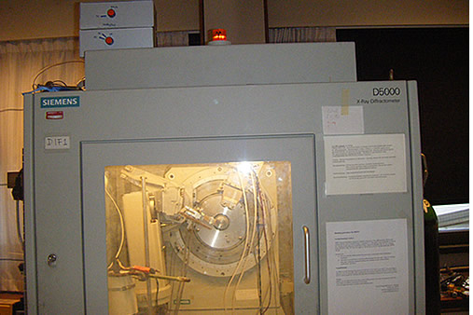
Powder XRD instruments
D 500
DIFF1

Slide 9
Sources
Material characterisation by Yang Leng
https://www.mn.uio.no/kjemi/english/research/about/infrastructure/xrd-lab/
http://www.ammrf.org.au/myscope/xrd/applications/
http://serc.carleton.edu/research_education/geochemsheets/BraggsLaw.html
http://serc.carleton.edu/research_education/geochemsheets/techniques/XRD.html
http://serc.carleton.edu/research_education/geochemsheets/techniques/SXD.html

